Slide 1


INSIGHTS ON PROPERTY INVESTMENT PROFITABILITY
By Rose Kyalo, Angel Atungire, Stacy Kiriiri, Brytone Omare

Slide 2




INTRODUCTION
King County is experiencing a surge in demand for high-quality properties, particularly those with larger living spaces, waterfront locations, and scenic views.
These features tend to command premium prices in the market, making them attractive investment opportunities.

Slide 3

BUSINESS PROBLEM
RASB-berry Property investors are looking to optimize their investment strategies by purchasing properties with the potential for high returns.
They want to know which property attributes, such as square footage, number of bedrooms,and condition of the property, are most strongly correlated with sale prices.

Slide 4



MODELLING
Baseline Model - Model 1
Multiple Linear Regression - Model 2
One Hot Encoding - Model 3

Slide 5
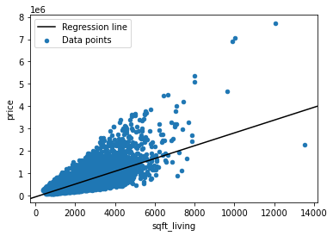
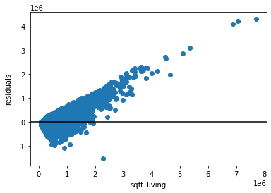
BASELINE MODEL
The data points show a linear relationship between sqft_living and price with a fitted regression line.
The distribution of the variance of the y values and y predicted are diverging on the positive side of the graph.

Slide 6
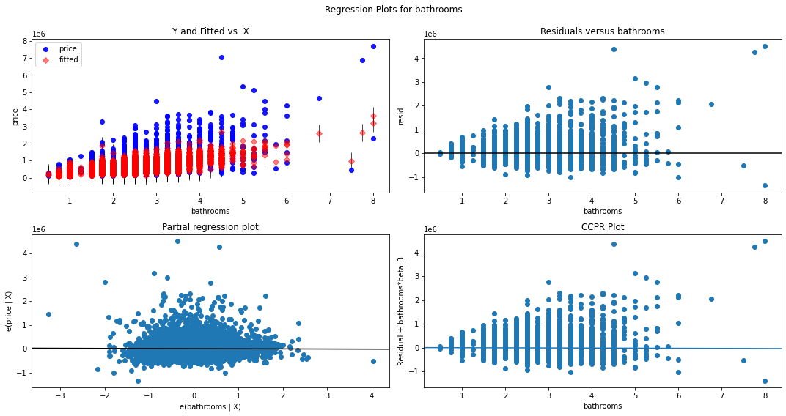
The bathroom variable may not be statistically significant to predict sale price.
Notes:
it is not significant for our analysis in the data provided

Slide 7

THIRD MODEL
After careful analysis of various models, we recommend the third model for RPI. This model has consistently outperformed other models in predicting housing prices, with an accuracy rate of 93%. Its ability to accurately predict price trends is crucial for making informed investment decisions.
It takes into account factors such as location, property features, and economic indicators to provide accurate forecasts. In addition, it has been tested on multiple datasets and has shown consistent performance across different market segments.

Slide 8
January
February
March
April
It is evident that that the opportune time tends to be during the middle months, spanning from April through July.
May
June
July
August
September
October
November
December
0
500
1,000
1,500
2,000

Slide 9
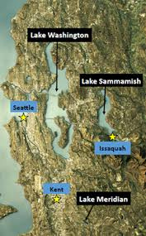
OUR
FINDINGS
Condition and Grade Influence Price: The condition and grade of a property are important factors affecting its price. Properties in very good condition and with higher grades tend to have higher values.
Square Footage Matters: The square footage of living space (sqft_living) has a significant positive impact on housing prices. Investing in properties with larger living spaces tends to result in higher prices.
Waterfront Properties Command a Premium: Waterfront properties are highly desirable and come with a substantial price premium. Investors should consider these properties for potentially higher returns.
Budget Planning: With an average housing price of approximately $541,317.18, investors should budget and plan their investments accordingly.
Views Enhance Value: Homes with excellent views or very good views also tend to fetch higher prices. This feature can be a valuable investment consideration.

Slide 10
RECOMENDATIONS
Square Footage Matters: The square footage of living space (sqft_living) has a significant positive impact on housing prices. Investing in properties with larger living spaces tends to result in higher prices.
Condition and Grade Influence Price:. Properties in very good condition and with higher grades tend to have higher values.
Waterfront Properties Command a Premium: Waterfront properties are highly desirable and come with a substantial price premium. Investors should consider these properties for potentially higher returns.
Budget Planning: With an average housing price of approximately $541,317.18, investors should budget and plan their investments accordingly.
Views Enhance Value: Homes with excellent views or very good views also tend to fetch higher prices.

Slide 11


THANK YOU
RECOMMENDATION

